Slide 1


Brian Heits
Principle Consultant
27th of August, 2025
Notes:
© Cerner 2016

Slide 2
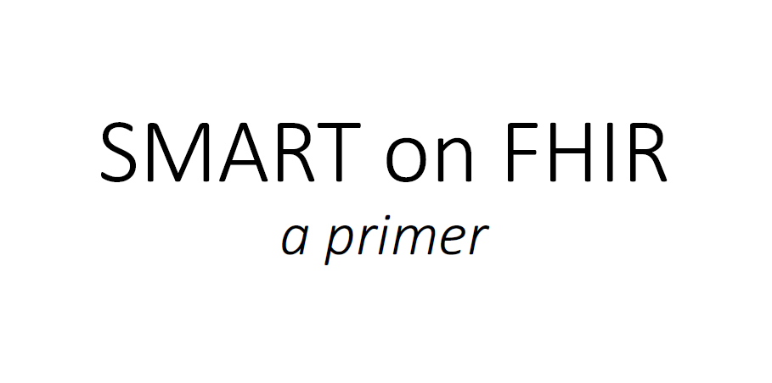

Slide 3
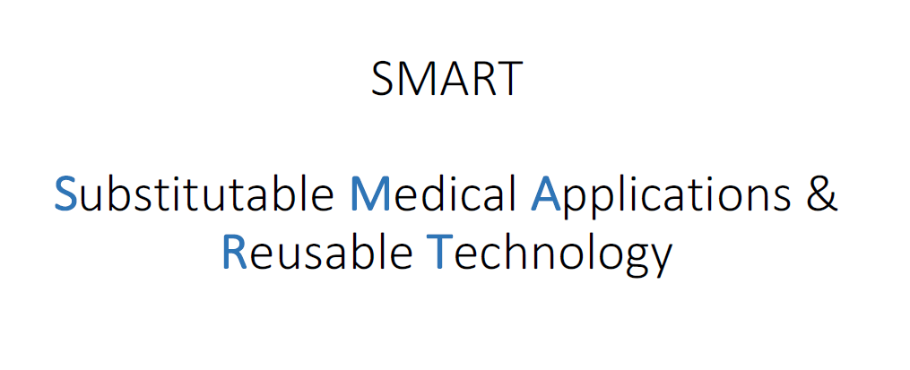

Slide 4
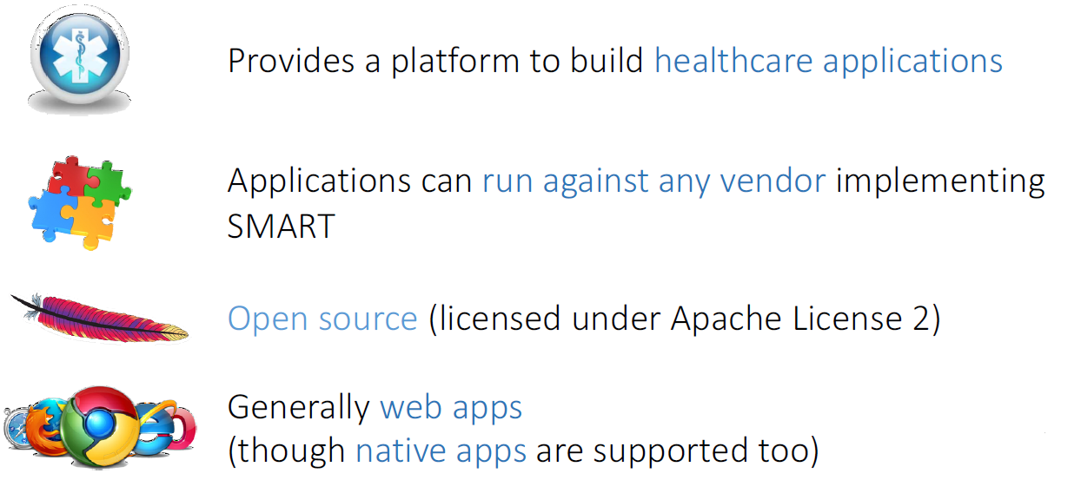

SMART Platform

Slide 5
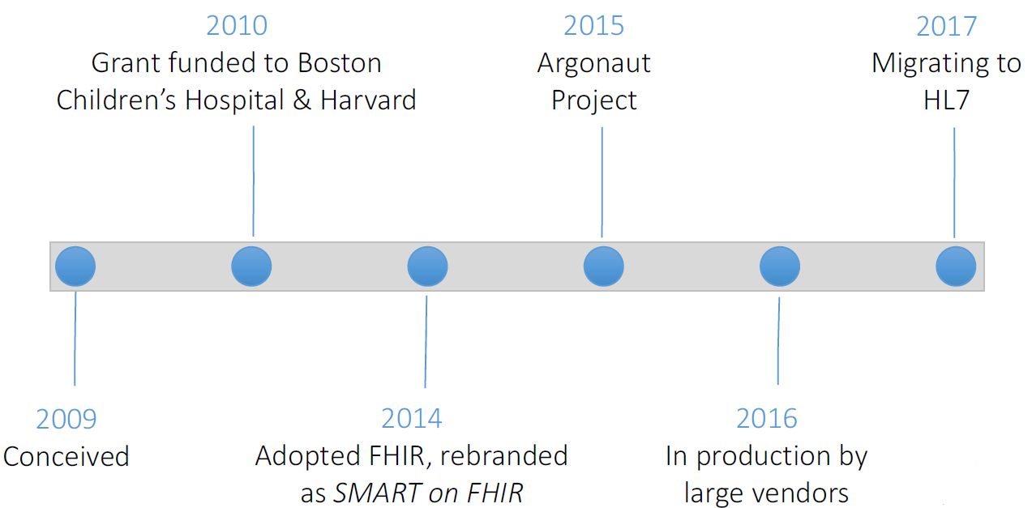
SMART > Trajectory

Slide 6
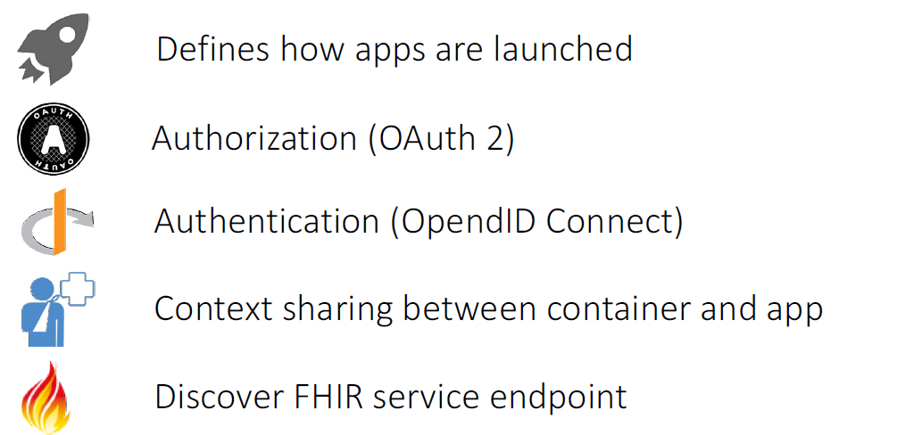
SMART > Platform Benefits

Slide 7


SMART > Platform Benefits

Slide 8
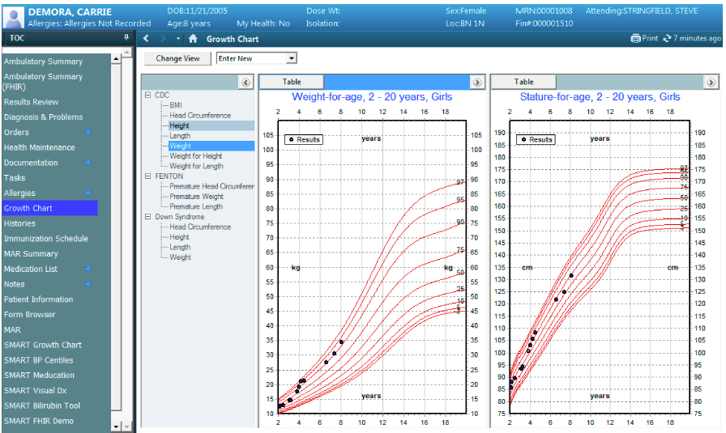
Growth Chart by Cerner

Slide 9
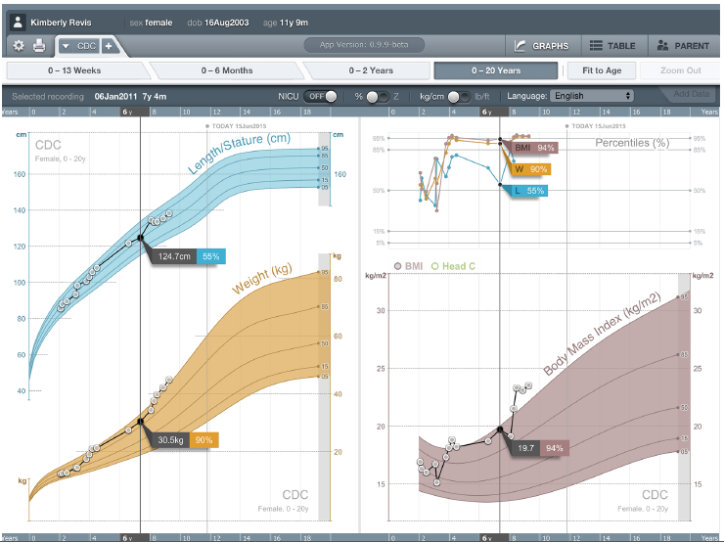
SMART Growth Chart by Boston Children’s Hospital

Slide 10
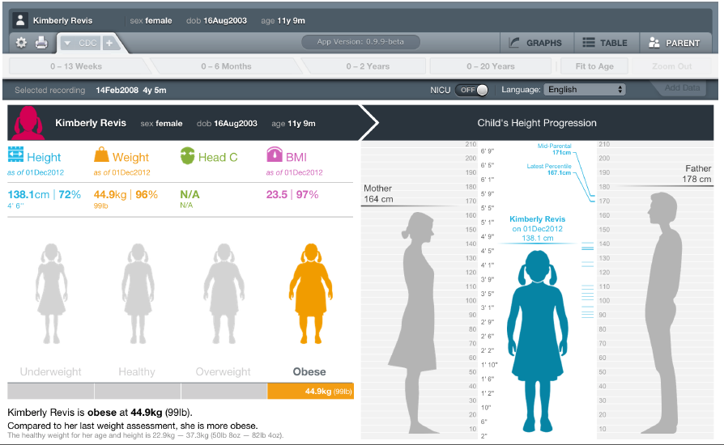
SMART Growth Chart by Boston Children’s Hospital

Slide 11
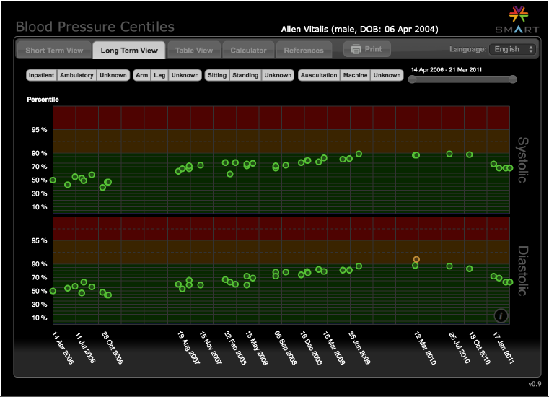
SMART BP Centile by Boston Children’s Hospital

Slide 12
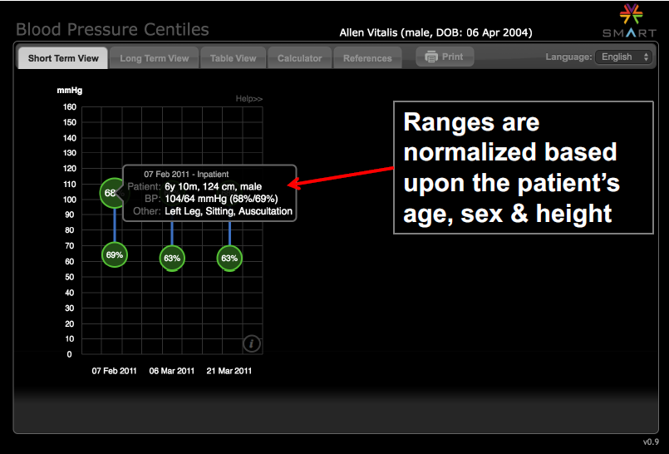
SMART BP Centile by Boston Children’s Hospital

Slide 13
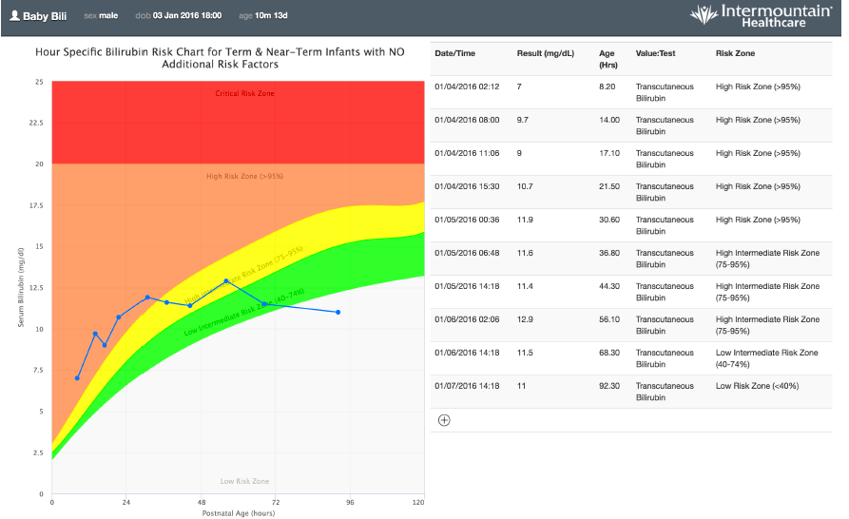
SMART Neonatal Bilirubin Alerts by Intermountain

Slide 14
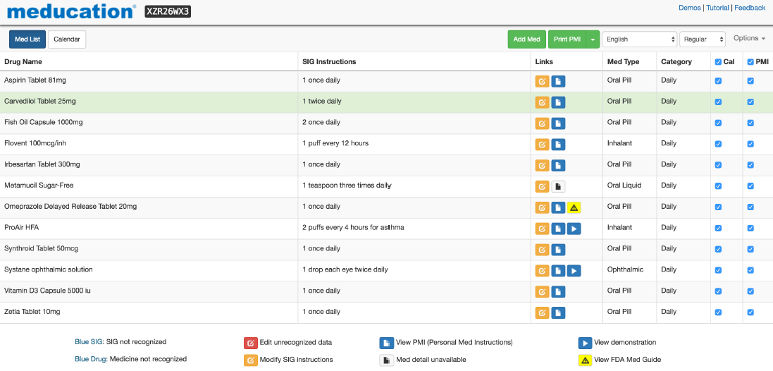
Meducation by Polyglot

Slide 15
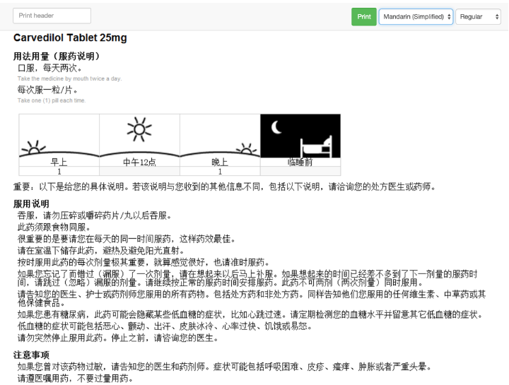
Meducation by Polyglot

Slide 16
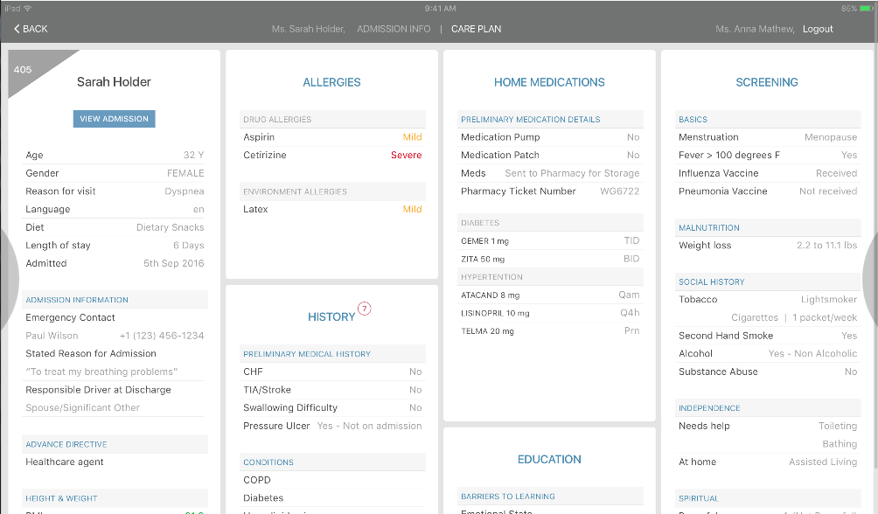
Mobile Nursing Assessment – St. Thomas/Ascension
Notes:
400 data elements to read/write and built initially as iOS app with Python handling SMART authentication

Slide 17
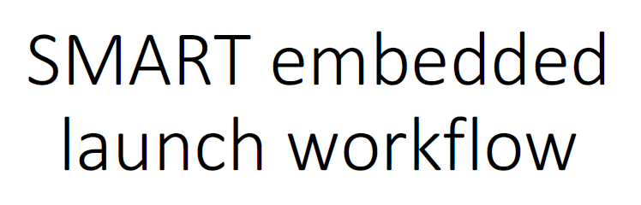

Slide 18
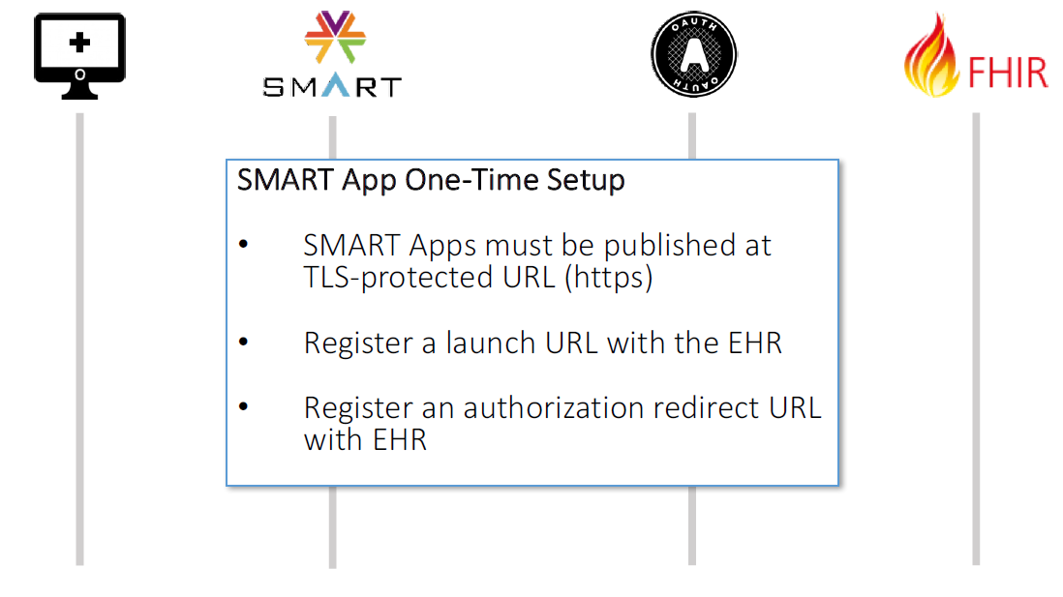

Slide 19
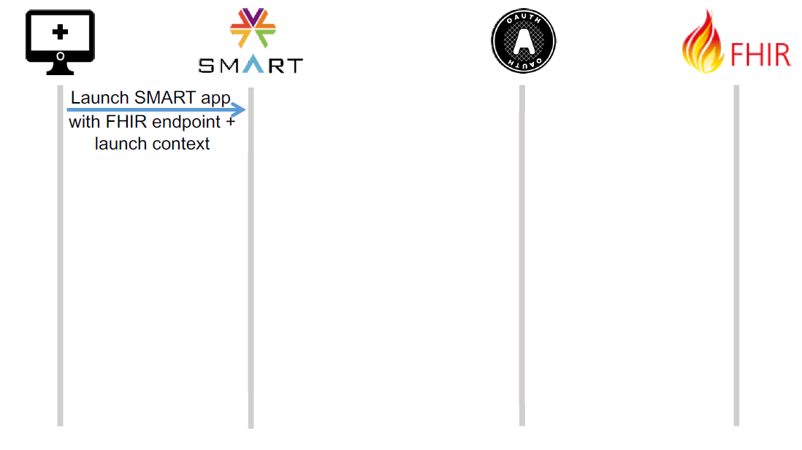
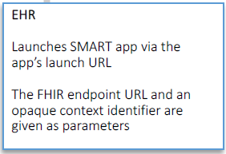

Slide 20
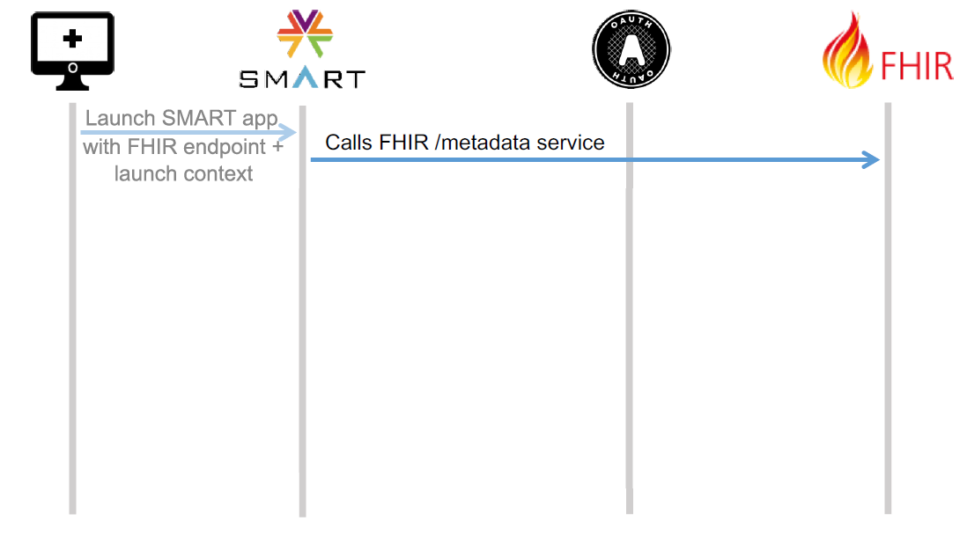
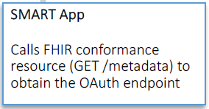

Slide 21
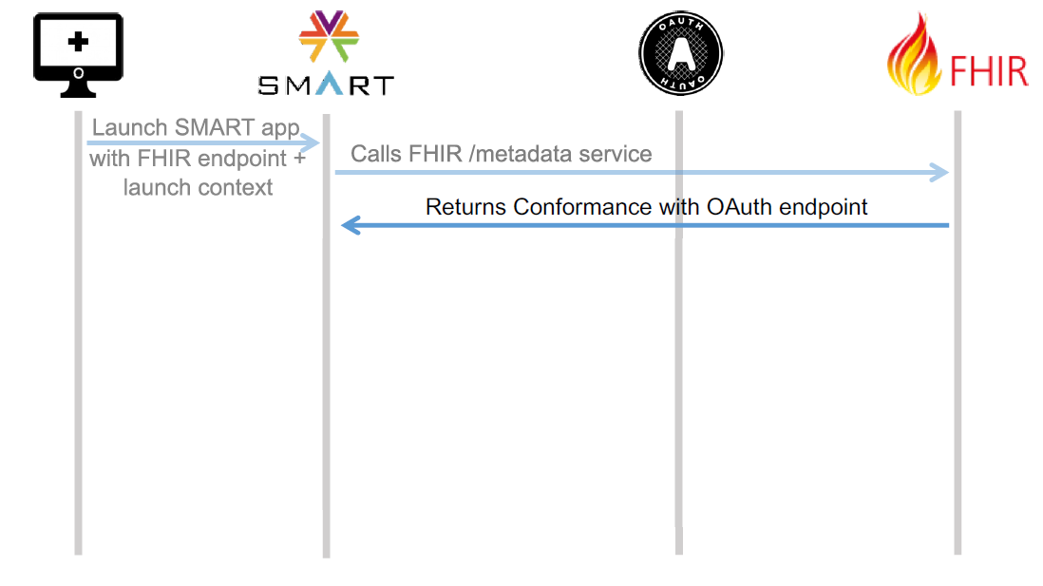
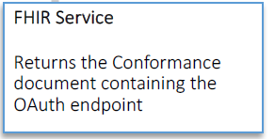

Slide 22
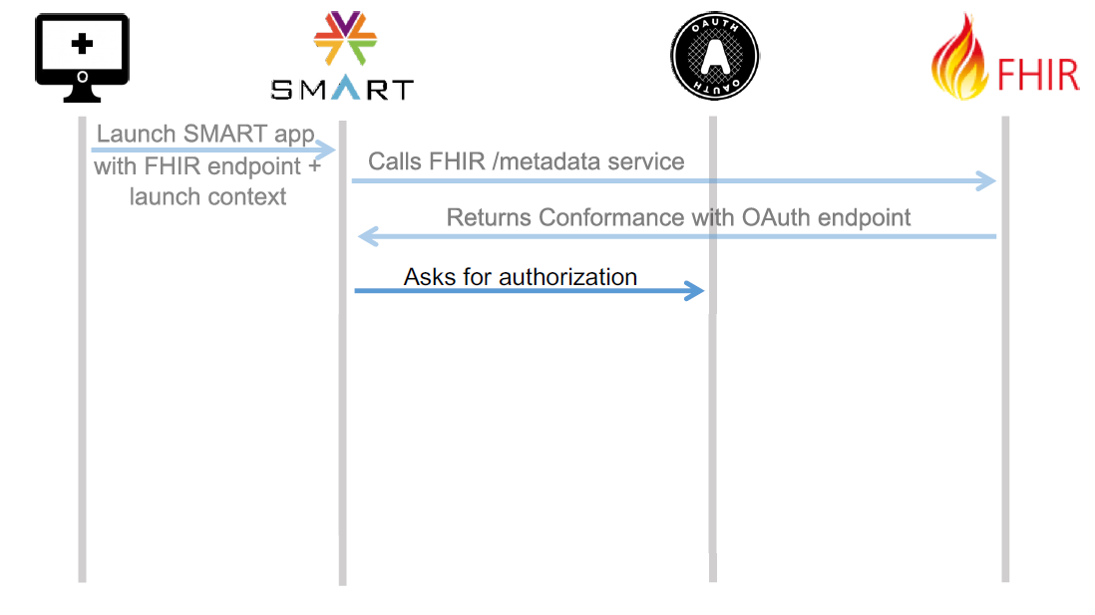
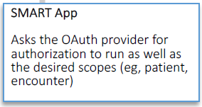

Slide 23
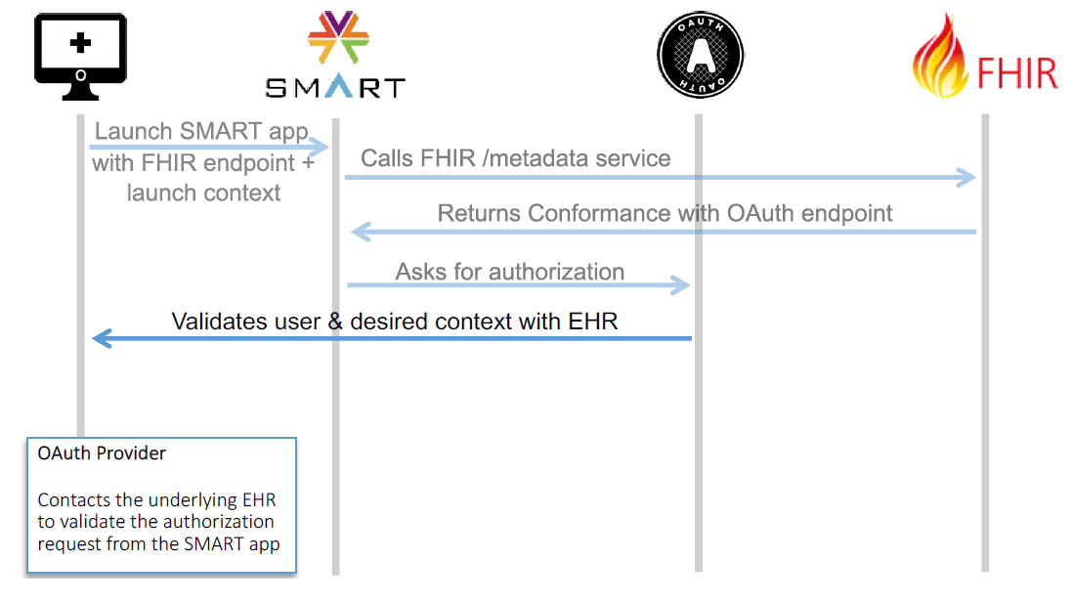

Slide 24
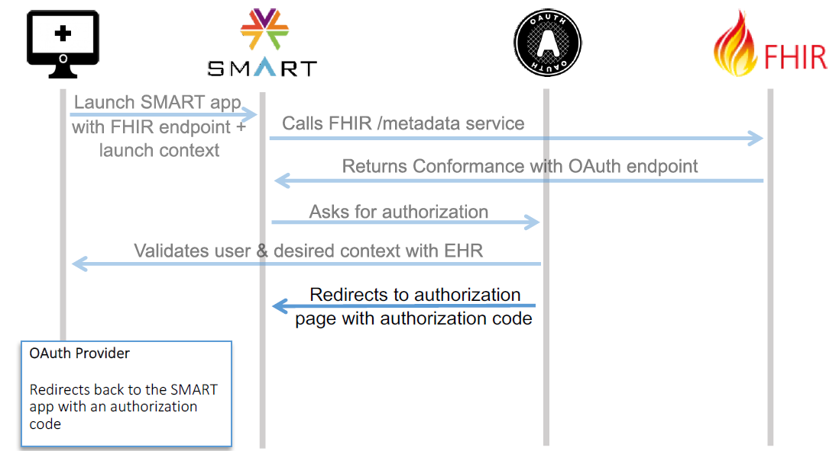

Slide 25
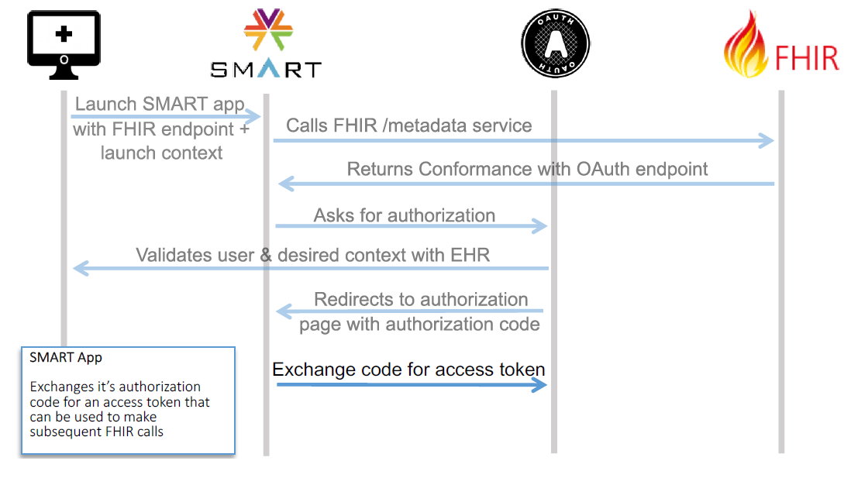

Slide 26
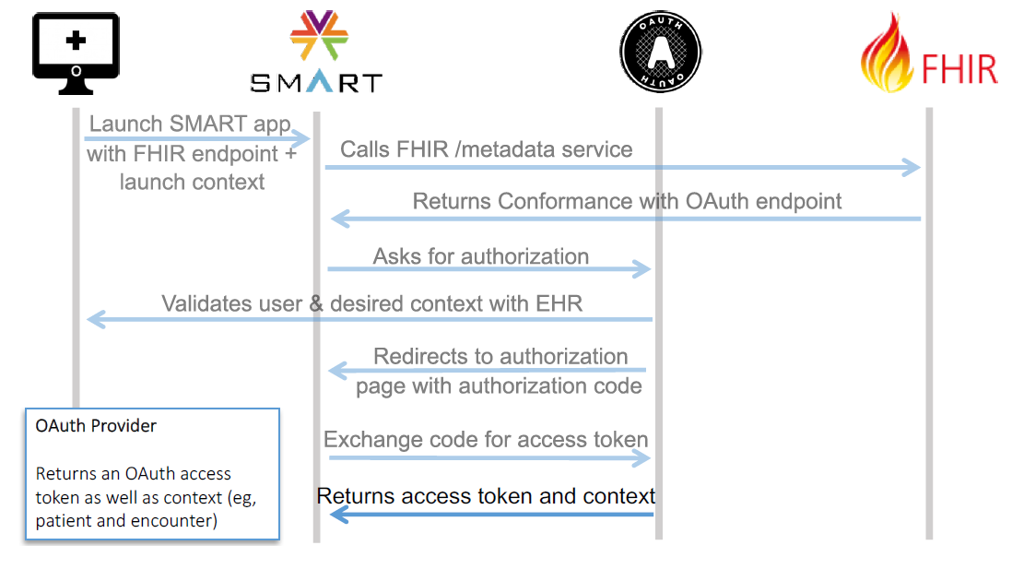

Slide 27
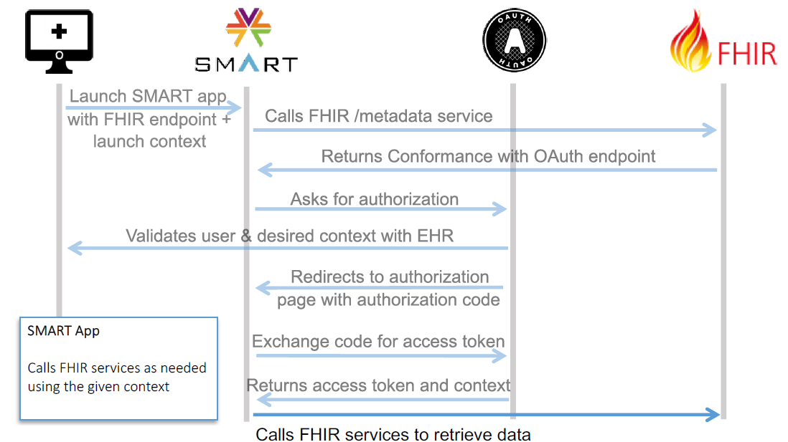

Slide 28
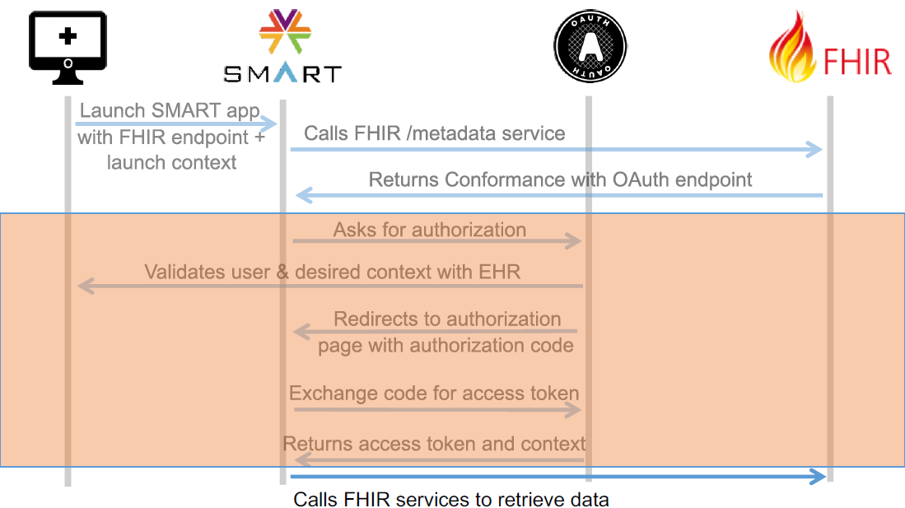

Slide 29





SMART > Community
smarthealthit.org
gallery.smarthealthit.org
docs.smarthealthit.org
chat.fhir.org | bit.ly/smart-google-group
github.com/smart-on-fhir

Slide 30
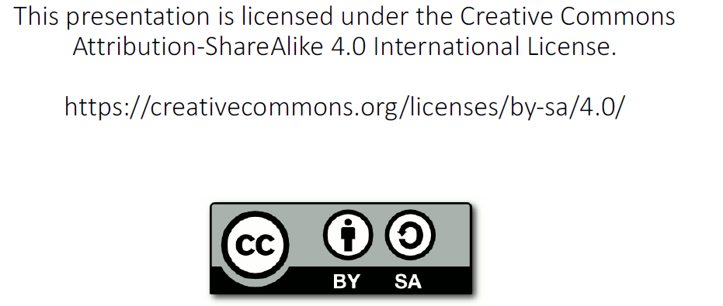
Questions?

Slide 31
Let’s Start!
http://engineering.cerner.com/smart-on-fhir-tutorial/#introduction

